Slide 1

Ballot Paper Identification using MobileNetV2 and Transfer Learning
Mohd Haaris Qureshi (20118054)
Vizan Sugee Verma (20118113)
Sawale Devesh Baburao (20118090)
Utkarsh Chaurasia (20118109)
Under Guidance of ​
Dr. Gyanendra Kumar Verma
Information Technology 7th Sem

Slide 2
Outline
Introduction
Literature Review
Methodology
Processed Model and Algorithms Used
System Architecture
Results & Discussion
Conclusion
Future Scope
References

Slide 3
Introduction
In modern democracies, election integrity is crucial, and ballot paper identification plays a key role. Traditional manual methods are prone to errors and biases.
The automated ballot paper identification through image classification, leveraging machine learning, enhances accuracy, reduces human error, and speeds up the process.
The automation of image classification for ballot paper identification has the potential to revolutionize the election process.
Considering these benefits we created a Ballot paper identification system.
The system takes an image of the ballot paper, and according to the image the election party is recognized.

Slide 4
Literature Review
There has been a growing interest in the application of image classification techniques for automated ballot paper identification
Offers a promising approach to address the limitations and enhance the accuracy, efficiency, and reliability of ballot paper identification.
Ballot paper identification focused on traditional ML algorithms, such as support vector machines (SVMs) and k-nearest neighbors (k-NN). However, their performance was limited by the feature extraction methods used, as their features are not robust to variations in ballot paper design.
The diversity in ballot paper designs requires models to adapt to different layouts, fonts, and marking styles, etc. Another challenge is the presence of noise and distortions in ballot paper images, such as folds, creases, and stains.

Slide 5
Literature Review
Despite these challenges, the potential benefits of image classification for ballot paper identification are substantial.
Hence, researchers explored the deep learning techniques, particularly convolutional neural networks (CNNs). CNNs can extract complex and hierarchical features from images, making them well-suited for tasks such as image classification. CNNs can achieve significantly higher accuracy.
Reduced human error and inconsistencies, improved processing speed, and minimum dependence on manual inspection.
Greater accuracy, efficiency, and reliability in the electoral process.

Slide 6
Methodology
1. Dataset:
We did not find an existing dataset suitable for our specific requirements in the public domain
We opted to create a synthetic dataset by crafting a voting slip pattern having 10 parties.
Achieved authenticity and diversity by systematically generating multiple samples by using python scripts.
The Dataset served as the foundation for training our voter slip identification system but also enabled us to fine-tune and validate its performance across a diverse range of scenarios.
Hence we could achieve adaptability and accuracy for our system
Following are some samples of the dataset created in the Image form:

Slide 7
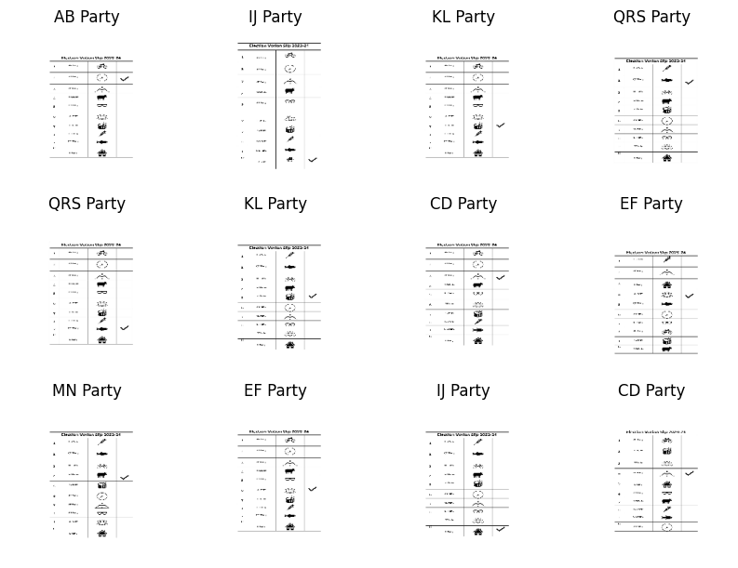
Some samples of dataset

Slide 8
Methodology
2. Data Preprocessing and Augmentation
Cleaning: Remove corrupt or irrelevant images.
Standardization: Resize, crop, and align images to a uniform size.
Normalization: Scale pixel values to [0, 1].
Augmentation: Apply transformations (rotation, flipping, noise) for dataset diversity.
3. Data Restructuring
Partitioning: Divide into training, validation, and test sets (stratified).
Training Set: Train the model.
Validation Set: Fine-tune hyperparameters, prevent overfitting.
Test Set: Evaluate the final model's performance.
4. Model Selection and Architecture Design
Selection: Choose pre-trained models (e.g., MobileNetV2, DenseNet201) for image classification.
Architecture: Define layers, activation functions, dropout, and batch normalization. Use transfer learning.
5. Model Training and Optimization
Initialization: Load pre-trained model weights, freeze specific layers.
Training: Use optimizers (SGD, Adam), loss functions (categorical cross-entropy). Monitor using accuracy and loss.
Tuning: Fine-tune hyperparameters with learning rate scheduling, early stopping, grid/random search.

Slide 9
Methodology
6. Model Evaluation and Validation​
Evaluation: Assess on the validation set using metrics (accuracy, precision, recall, F1-score).​
Adjustment: Modify hyperparameters based on validation results.​
Cross-Validation: Implement k-fold cross-validation for robustness.​
7. Testing and Deployment​
Final Evaluation: Assess performance on the untouched test set.​
Deployment: Deploy the trained model based on computational needs (on-premise, cloud-based, or edge-based).​
8. Future Considerations and Improvement​
Scalability: Discuss handling large datasets and adaptability to new ballot papers.​
Continual Improvement: Address strategies for ongoing model refinement.​
Ethical Considerations: Consider biases, fairness, and transparency in predictions.​
9. Documentation and Reporting​
Comprehensive Documentation: Cover dataset details, model architecture, hyperparameters, training logs, and evaluation results.​
Report Writing: Summarize methodology, findings, limitations, and future directions. Include visualizations, code snippets, and references.

Slide 10
Process Methodology
We have proposed a CNN based model with MobileNetV2 as the base model and fully connected dense layers along with optimizers
Transfer Learning:
We have employed transfer learning by using MobileNetV2 as a pre-trained base and then this model is then trained on our self-made dataset of Ballot paper slips.
Transfer learning leverages knowledge learned from one task (ImageNet classification) to improve performance on a different task (Ballot paper slip detection).
Feature selection the pre-trained model allows it to adapt to our self-made dataset.
Base Model (MobileNetV2):
MobileNetV2 serves as the foundation for our model.
It’s a lightweight convolutional neural network (CNN) architecture designed for mobile devices.
MobileNetV2 provides a good balance between accuracy and computational efficiency.
Optimizer (SGD):
We have chosen Stochastic Gradient Descent (SGD) as the optimizer.
With a learning rate of 0.001 and momentum of 0.8, SGD helps update model weights during training.
Momentum accelerates convergence by considering past gradients.

Slide 11
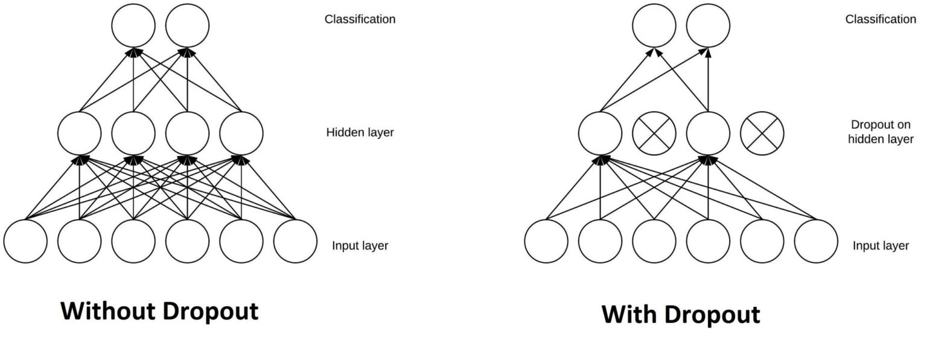
Process Methodology
Fully Connected Layers:
After the MobileNetV2 base, we ’ve added fully connected layers.
These layers learn complex patterns and features from the extracted features.
The use of ReLU activation (Rectified Linear Unit) introduces non-linearity, allowing the model to capture intricate relationships.
Dropout Layer:
The dropout layer (with a rate of 0.1) helps prevent overfitting.
During training, it randomly drops a fraction of neurons, encouraging robustness.

Slide 12
Process Methodology
SoftMax Layer:
The final layer is a SoftMax layer.
It converts model predictions into probabilities for each class (in our case, 10 classes).
The class with the highest probability becomes the predicted label.
In summary, our approach combines transfer learning, feature extraction, and a well-structured neural network architecture to detect ballot paper voting slips effectively.

Slide 13
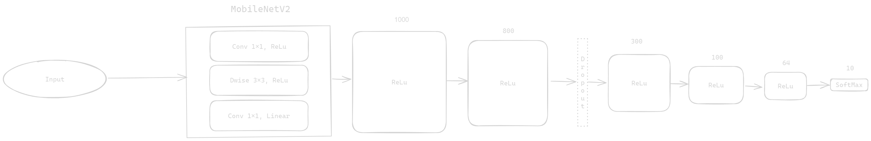
System Architecture:

Slide 14
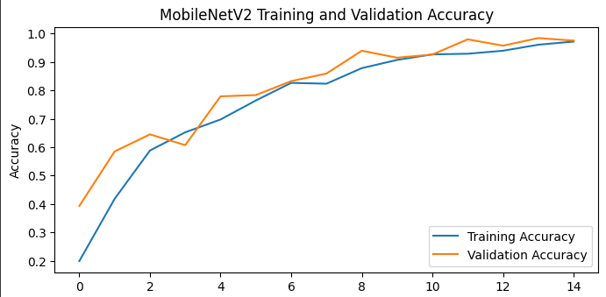
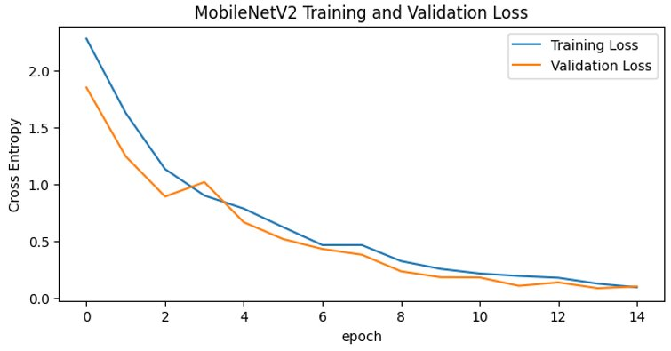
Results
After training and validating the model we plot the Training and Validation accuracy against the epochs counts, it resulted in the above graph
After training and validating the model we plot the Training and Validation loss against the epochs counts, it resulted in the above graph ​
​
​

Slide 15
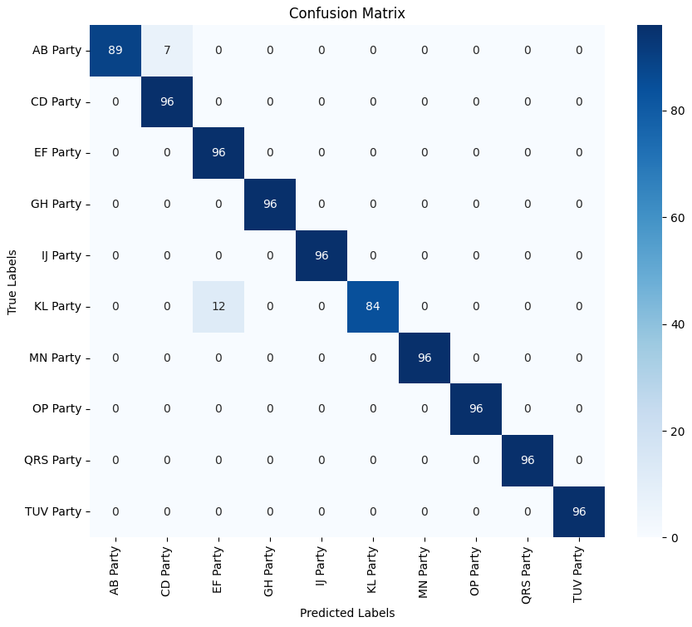
Results
Confusion Matrix:
Represent a model's performance.
Depicts the actual versus predicted classifications.
The matrix has rows representing the actual classes and columns for the predicted classes.
In this context, the confusion matrix is a square matrix with dimensions equal to the number of classes, where each cell [i, j] represents the number of instances where class i was predicted as class j.

Slide 16
Results
Class | Precision | Recall | F1-Score | Support
AB Party | 1.00 | 0.93 | 0.96 | 96
CD Party | 0.93 | 1.00 | 0.96 | 96
… | … | … | … | …
QRS Party | 1.00 | 1.00 | 1.00 | 96
TUV Party | 1.00 | 1.00 | 1.00 | 96
Average | 0.98 | 0.98 | 0.98 | 96
This chart visually demonstrates the precision, recall, and F1-score metrics for each political party class, alongside the macro average, providing a graphical representation of the model's performance across the various party categories.
The model achieves an impressive 98% overall accuracy, affirming its ability to predict party affiliations accurately.

Slide 17
Conclusion & Future Scope
This project showcases how far we've come in using smart technology to sort images better. By working hard on preparing data and building a strong MobileNetV2 model, we've shown it can tell different things apart with good accuracy. This means it could be really useful in real-life situations. We also looked into different ways to make the model work even better, like adjusting its settings to get the best performance.
Looking ahead, there's lots more we can do. Exploring new methods and fancier models beyond MobileNetV2 could make our sorting even more accurate and faster. Making the model smarter by teaching it from other data or using new tricks to make our dataset bigger could help it understand things even better. If we try it out in real situations, like identifying ballot papers, and keep teaching it as things change, it could be a big help. Figuring out how the model makes decisions and making sure it's fair and unbiased are also really important steps for the future. Overall, there's a lot of exciting things we can do to make this technology even better for solving real problems.

Slide 18
References
[1] J. Kang, J. Ahn, and C. Park, “Ballot paper recognition using support vector machine,” in Proc. Int. Conf. Pattern Recognition, 2002, pp. 566-570.
[2] N. Kato, J. Imoto, and Y. Nakamura, “A study on ballot paper recognition using k-nearest neighbors' algorithm,” in Proc. Int. Conf. Pattern Recognition, 2000, pp. 619-622.
[3] Y. Liu, Y. Zhang, X. Yang, and Z. Ren, “Ballot paper recognition using convolutional neural networks,” in Proc. Int. Conf. Pattern Recognition, 2016, pp. 3717-3722.
[4] S. Al-Busaidi, S. A. Fahmy, and M. A. Shehata, “Ballot paper recognition using convolutional neural networks,” in Proc. Int. Conf. Image Processing, 2017, pp. 4286-4290.
[5] P. Kumar, R. Sharma, and V. K. M. Rao, “Ballot paper recognition using convolutional neural networks with transfer learning,” in Proc. Int. Conf. Computer Vision, 2019, pp. 6072-6080.
[6] J. Wu, X. Lu, J. Zhang, and J. Liu, “Robust ballot paper recognition using convolutional neural networks and spatial attention mechanism,” in Proc. Int. Conf. Artificial Intelligence and Applications, 2019, pp. 1187-1192.
[7] W. Zhang, Y. Li, and L. Zhao, “Noise-resistant ballot paper recognition using convolutional neural networks and adaptive batch normalization,” in Proc. Int. Conf. Pattern Recognition, 2020, pp. 107-112.
[8] H. Li, X. Yang, and S. Zhang, “Generalizable ballot paper recognition using convolutional neural networks and transfer learning,” in Proc. Int. Conf. Image Processing, 20

Slide 19
References
[9] Y. Jia, E. Shelhamer, J. Donahue, S. Karayev, J. Long, R. Girshick, S. Guadarrama, T. Darrell, "Caffe: Convolutional Architecture for Fast Feature Embedding," in Proceedings of the ACM International Conference on Multimedia (ACMMM), 2014.
[10] K. Simonyan, A. Zisserman, "Very Deep Convolutional Networks for Large-Scale Image Recognition," in Proceedings of the International Conference on Learning Representations (ICLR), 2015.
[11] S. Ren, K. He, R. Girshick, J. Sun, "Faster R-CNN: Towards Real-Time Object Detection with Region Proposal Networks," in Advances in Neural Information Processing Systems (NeurIPS), 2015.
[12] Y. LeCun, C. Cortes, C. J. Burges, "The MNIST Database of Handwritten Digits," in IEEE Transactions on Neural Networks, 1998.
[13] K. He, X. Zhang, S. Ren, J. Sun, "Deep Residual Learning for Image Recognition," in Proceedings of the IEEE Conference on Computer Vision and Pattern Recognition (CVPR), 2016.
[14] F. Zhuang, D. Shen, "Squeeze-and-Excitation Networks," in Proceedings of the IEEE Conference on Computer Vision and Pattern Recognition (CVPR), 2018.
[15] H. Noh, S. Hong, B. Han, "Learning Deconvolution Network for Semantic Segmentation," in Proceedings of the IEEE International Conference on Computer Vision (ICCV), 2015.

Slide 20
Thank You :)

